Slide 1



Date
May 21, 2025
Customer Segmentation & Repeat Order Prediction
by
Batch
Assignment
Linkedin
Link
Ahmad Rizki
RevoU FSDA batch FEB25
DEEP Project
M1M2
M3M4
www.linkedin.com/in/arizabdulhanan
Google Collab Link
Spreadsheet Link
Tableau Link

Slide 2

Executive Summary
Problem
Metrics
Olist ecommerce has a fairly low repeat order rate around 3% of the total 94,427 customers.
Some metrics used for analysis can be seen in the metrics ‘slide 26’ and ‘slide 27’
Objective
Findings
To find the right method to increase repeat order rate from 3% to 10% for 2019 period and preparation for seasonal event in 2018.
Customers who make repeat orders mostly tend to like products in the electronics and gaming category, live in Sao Paulo, sensitive with a high price, and give 5 star ratings.
Tools
Recommendation
The tools used in this project are Spreadsheet, Python, and Tableau.
Propose actionable solutions to improve the overall customer experience, KPI that monitored some critical metrics, and predict high potential repeat buyers.
1

Slide 3

Data Overview & Project Scope
Olist Store is a real ecommerce store which located in Brazil. They operate using B2C model that connects small business from all over Brazil to channels without hassle and with a single contract. Olist help the merchants to compete in Brazilian market by increasing their online sales while minimizing operational complexities by simplified listing process, unified order management, and data analytics. Those merchants are able to sell their products through the Olist Store and ship them directly to the customers using Olist logistics partners. After a customer purchase the product from Olist Store, a seller gets notified to fulfill that order.
Olist generates revenue mainly through monthly subscriptions, commissions on sales, advertising fees, and premium features.
This sample is collected from kaggle.com.
The project scope :
Olist daily transactions of 97k orders from 2017 to 2018
Records over 1 years and half from January 2017 to August 2018
Exclude geolocation table from analysis
2

Slide 4
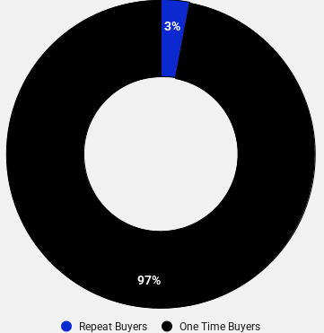
Background of Project
In the world of e-commerce, every click, purchase, and interaction matters. Online marketplaces like Olist have made shopping more convenient and accessible, connecting customers with products from all over the world. But behind every seamless transaction is a series of complex interactions that influence whether a customer will come back for more.
Despite the boom in online shopping, many e-commerce platforms face common challenges. In this case, compared to the Brazil national data with 77.2% of repeat order rate for e-commerce in 2017, Olist just having a repeat order rate for 3% from total customers. This condition can directly impact traffic, sales, and brand loyalty in the future.
This project aims to explore the key pain points in Olist’s e-commerce platform, analyze the causes of this situation, and propose actionable solutions to improve the overall customer experience.
Our goal is to find actionable insights that will help Olist create a better, more seamless shopping experience, not only drives sales but builds lasting relationships with customers.
Source : ‘Brazil National Data’
3

Slide 5

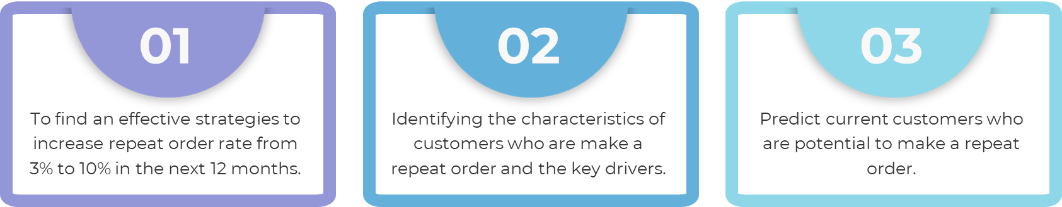
Project Goals
Business Problem
“How to increase its customer repeat order rate from 3% to 10% over the next year by leveraging customer segmentation insights and building a predictive model to identify and target high-potential repeat buyers?”
Objectives
4

Slide 6
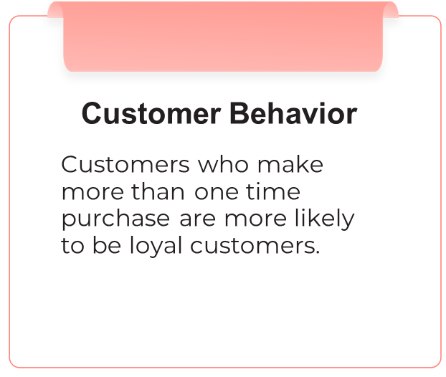
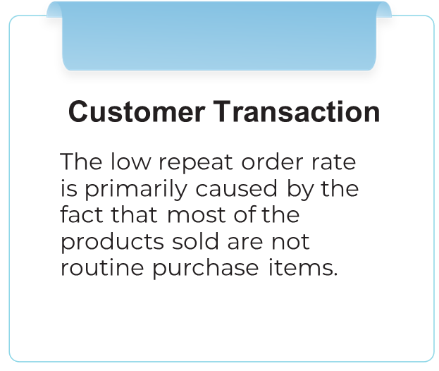
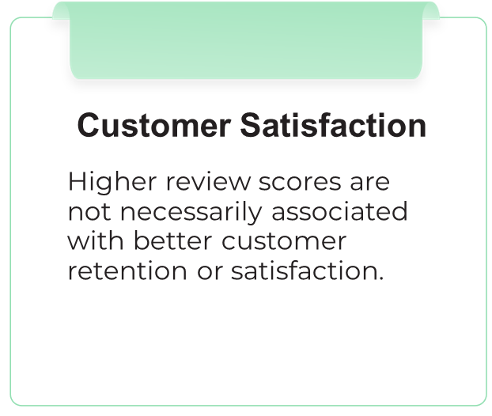
Hypothesis
Source : ‘Root Cause Analysis’
5

Slide 7


















Research Methodology
Data Collection
Data Analysis
Business Insights & Recommendation
Gather dataset from kaggle.com.
Generate insight from data by using software : Spreadsheet, Python, and Tableau.
Summarize all the insight and make a business recommendation based on that insights for the stakeholder.
Business Understanding
Data Preparation
Customer Segmentation &
Random Forest Classifier
Understand what is the business question and how to answer the question.
Handling duplicate, missing value, irrelevant column, unmatched rows, format data type, and typo by using Python.
Segmenting customers into several clusters and Predicting customers who will make a repeat order.
6

Slide 8
Customer Behavior
Analysis

Slide 9

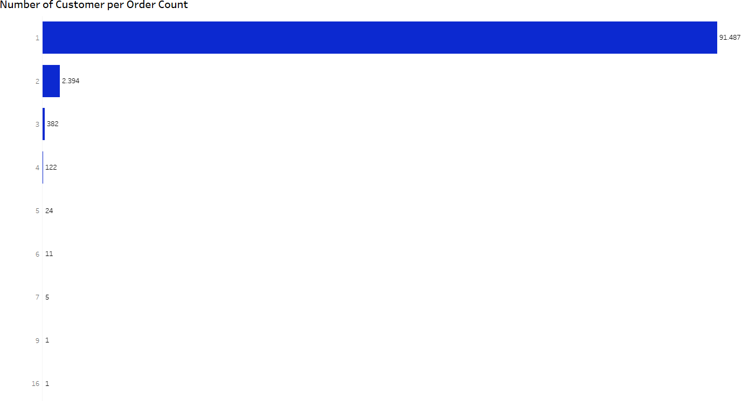
Almost 97% of Customers Are One-Time Buyers, Revealing Low Retention
Key points :
There was a big different between number of customer who make a repeat order and not.
Company successful to get new customer, but failed when convert it into repeat buyers.
2,940 customers
7

Slide 10

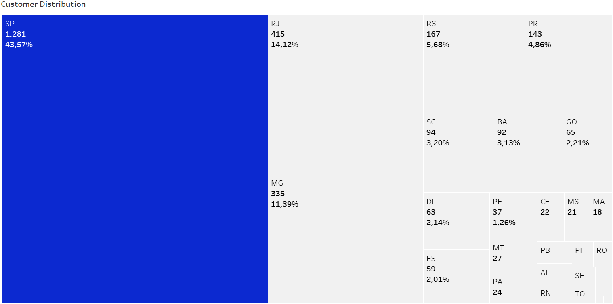

Target High-Value Customers with Special Offers in Key Brazilian States
Key points :
Sao Paulo, Rio de Janeiro, Minas Gerais, Rio Grande do Sul, and Santa Catarina is a big state with strong economy.
Sao Paulo has the biggest number with 43% of repeat buyers.
8

Slide 11
Customer Transaction
Analysis

Slide 12

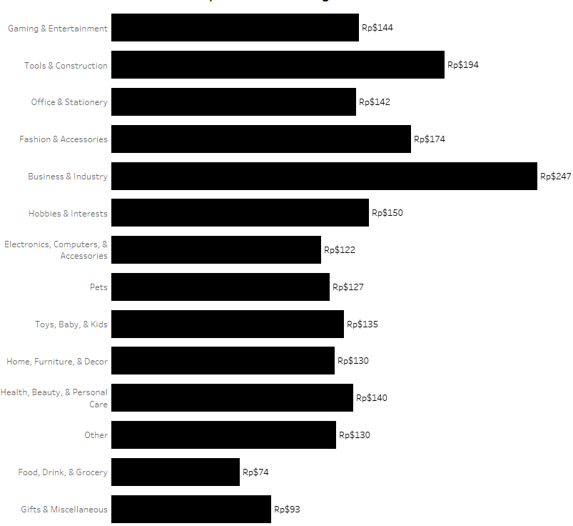
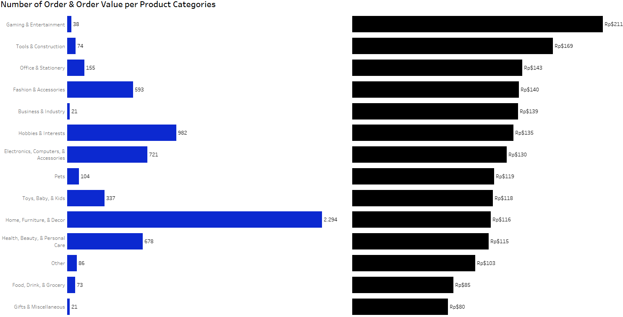
Repeat Buyers Outspend One-Time Shoppers—But Only in Select Categories
One Time Buyers
Repeat Buyers
Key points :
This insight can be use to increase order value.
9

Slide 13
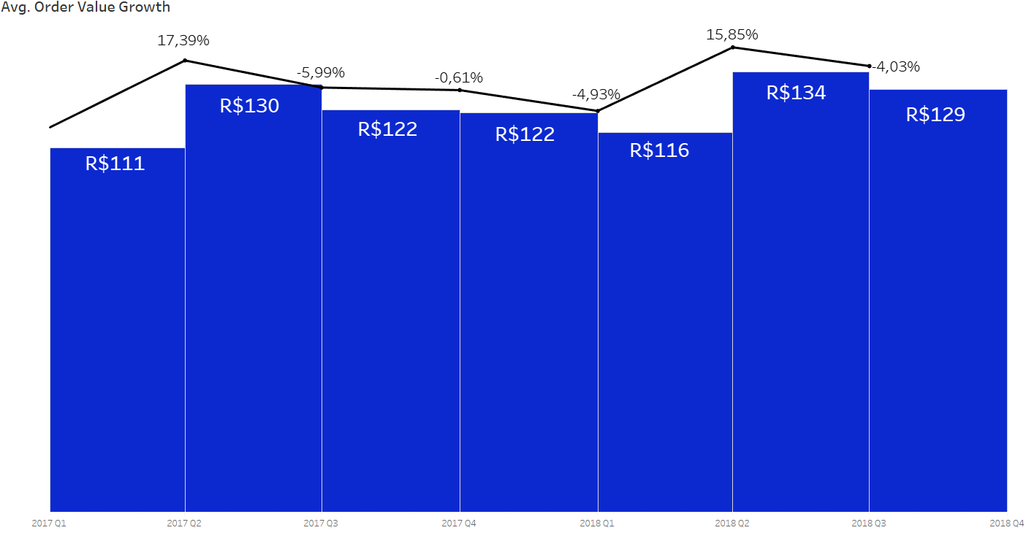
Average Order Value from Repeat Buyers Fluctuates Each Quarter
Key points :
There is a pattern of significant increase in avg. order value in every second quarter.
It may cause by many electronics and gaming companies release new products or version during second quarter (April - June), but only a few repeat buyers who will buy.
10

Slide 14
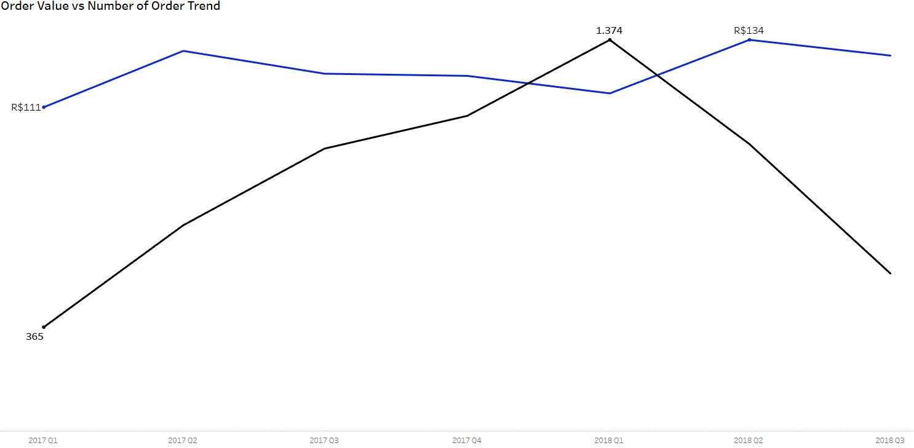
Order Volume and Order Value from Repeat Buyers Show an Inverse Seasonal Correlation
: Avg. Order Value
: Number of Order
Key points :
Due to seasonal event ‘black friday’ on November 2017, Quarter 1 2018 may become clearance part from retailers.
It may cause by complementary accessories purchase related to electronics and gaming.
Off peak periods attract fewer but higher spending customers.
Source : ‘black Friday’
11

Slide 15
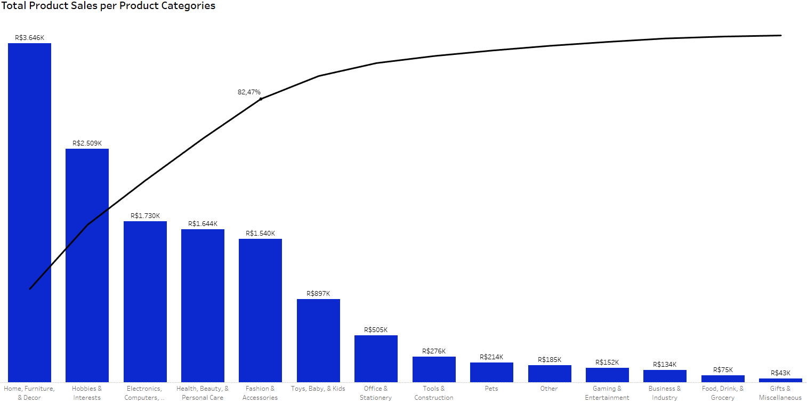
From Top 5 Categories Drive 80% of Product Sales, Only One Product Category That Repeat Buyers Spend More
Key points :
Electronic is not a category that will make daily sales, so it may cause a small number of routine purchases which also affects the repeat order rate.
Only two categories that are consumer goods.
12

Slide 16
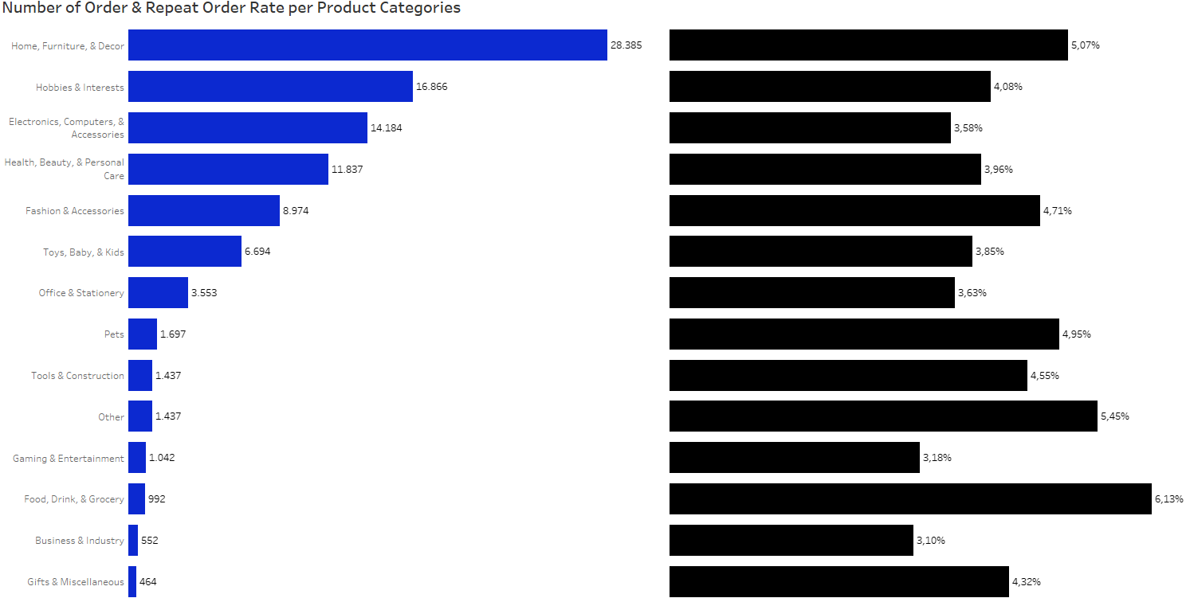
From Top 5 Categories Drive 80% of Product Sales, Electronics Has Lowest Repeat Order Rate
Key points :
Even repeat buyers can spend more on Electronic category, but that category is a very seasonal product.
: Number of Order
: Repeat Order Rate
13

Slide 17
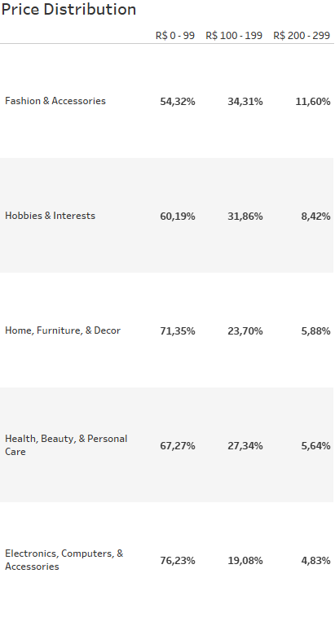
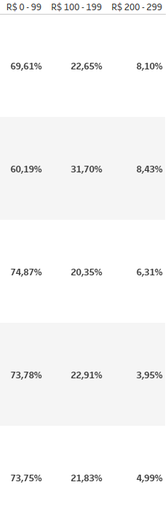
From Top 5 Categories Drive 80% of Product Sales, The majority of Customers Transactions Fall within Low Price ranges.
One Time Buyers
Repeat Buyers
Key points :
Electronics tends to be more elastic than Others for One Time Buyers and also Repeat Buyers.
14

Slide 18
Customer Satisfaction
Analysis

Slide 19
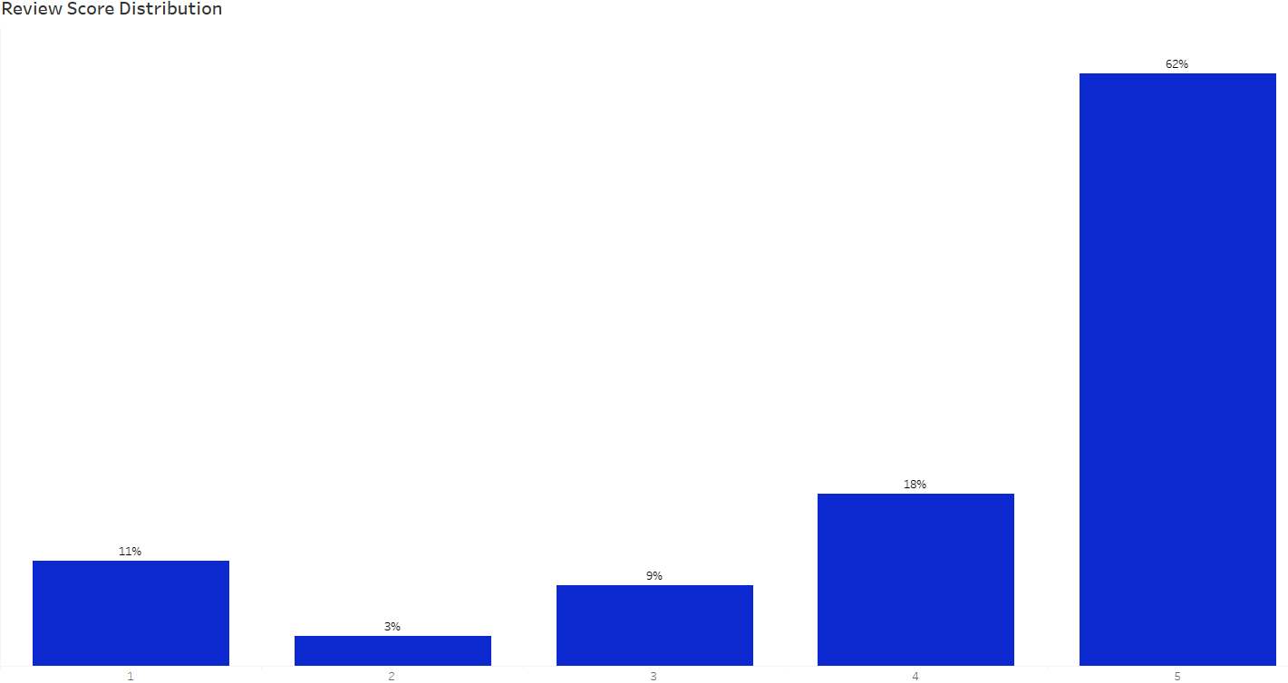
62% Repeat Buyers are Satisfied with Give Top Ratings
15

Slide 20
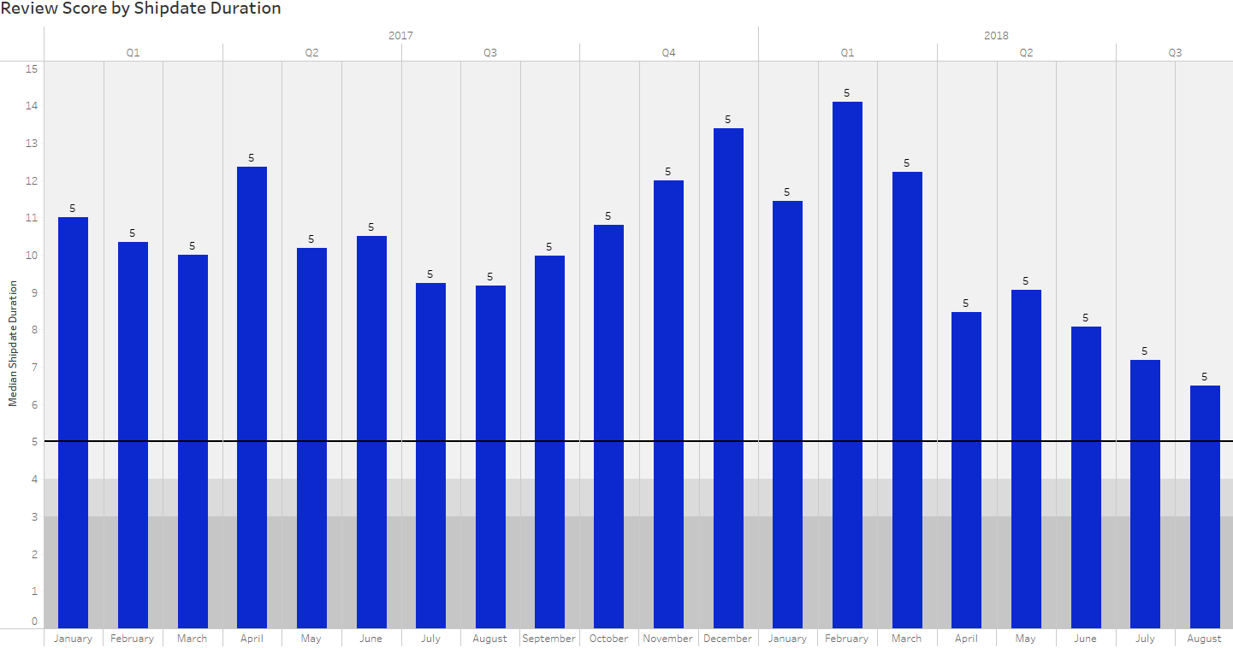
High Review Scores Can Be Misleading Without National Benchmarking
: Avg. Shipdate
: Rating score
Key points :
Compared to the national average for domestic e-commerce logistics in Brazil (range 5 - 8 days) for 2017, the partner's delivery performance is significantly slower with (range 9 - 13 days) for 2017, indicating inefficiencies that could impact customer satisfaction and competitiveness.
There was an improvement in delivery performance with (range 6.5 - 14 days) in 2018. (please refer to ‘slide 32’)
Source : ‘Logistics Performance of Virtual Stores in Brazil’
16

Slide 21
Recommendations
Maximize seasonal / high peak opportunities
Launch early bird campaigns before November 2018 ‘black Friday’ peak season for customer in Top 3 decile with giving loyalty programs or exclusive discount for second purchase, in order to convert a new customer into repeat buyer and increase repeat order rate. (refer to slide 40)
During Quarter 2 when many electronics and gaming companies release new products or version, make a special offer or pre-book for repeat buyers with upselling price, but still in a budget range.
Since most of product category are not daily sales categories, we can educate consumers post-purchase with product usage guides or game recommendations to drive complementary accessories sales.
Add more types of consumer goods product categories.
Realign review & feedback mechanism
Launch post delivery surveys like CSAT separate from star ratings.
Reduce freight delays to build trust
Find another logistic partners that offer faster freight duration.
Introduce SLA based penalties for sellers with slow processing.
Make a customer can track orders in real time and set realistic expected duration.
Make a different approach to increase repeat order based on customer’s cluster (refer to slide 36)
Budget Buyers : offer product bundles within their budget range and offer points or tier rewards for more frequent purchases.
High Value Buyers : create exclusive offers or new release access.
High Volume Buyers : offer small discounts after a few purchases.
Repeat Buyer Big Spenders : prioritize these clients in the risk score for retention efforts and offer compensation to encourage another purchase.
17

Slide 22
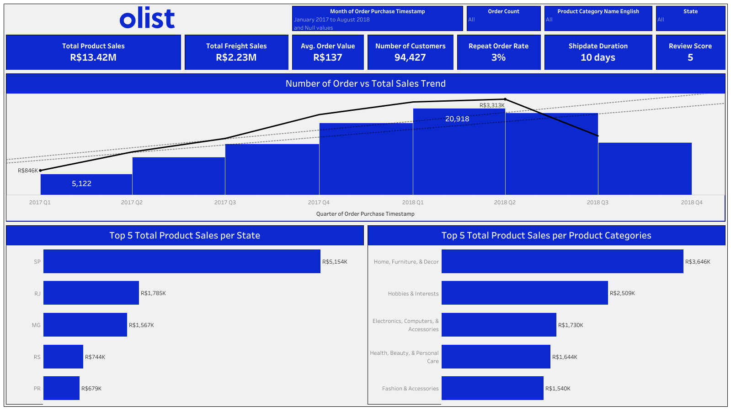
18

Slide 23
Date
May 21, 2025
Thank You
For Your Attention…
by
Batch
Assignment
Linkedin
Link
Ahmad Rizki
RevoU FSDA batch FEB25
DEEP Project
M1M2
M3M4
www.linkedin.com/in/arizabdulhanan
Google Collab Link
Spreadsheet Link
Tableau Link

Slide 24
Appendix

Slide 25

Root Cause Analysis
The distribution of the number of repeat buyers is only concentrated in several state.
Customer Behavior
Customers who make more than one time purchase are more likely to be loyal customers.
Repeat buyer transactions show seasonal fluctuations.
Repeat Order Rate
(3%)
Customer Transaction
Repeat buyers will spend more in specific product categories.
The low repeat order rate is primarily caused by the fact that most of the products sold are not routine purchase items.
The company has not been efficient in setting the expected duration of freight.
Location Performance
States with more sellers lead to lower freight cost and higher total sales.
Customer Satisfaction
Higher review scores are not necessarily associated with better customer retention or satisfaction.
19

Slide 26
Metrics
Actionable Metrics
Metrics | Analysis Methods
Number of Customer per Order Count | Descriptive Analysis
Customer Distribution | Descriptive Analysis
Average Order Value Growth | Trend Analysis
Order Value vs Number of Order Trend | Trend Analysis
One Time Buyers vs Repeat Buyers Order Value | Descriptive Analysis
Total Product Sales per Product Categories | Descriptive Analysis
Number of Order & Repeat Order Rate per Product Categories | Descriptive Analysis
20

Slide 27
Metrics
Actionable Metrics
Metrics | Analysis Methods
Price Distribution | Descriptive Analysis
Payment Method Preferences | Descriptive Analysis
Avg. Sellers processing, to Carrier, and Ship Duration | Trend Analysis
Expected vs Actual Shipdate | Trend Analysis
Expected vs Actual Shipdate Days Distribution | Descriptive Analysis
Total Sales & Avg. Freight Cost Distribution per State | Descriptive Analysis
Review Score Distribution | Descriptive Analysis
Review Score by Shipdate Duration | Descriptive Analysis
21

Slide 28
Eksploratory Data Analysis

Slide 29
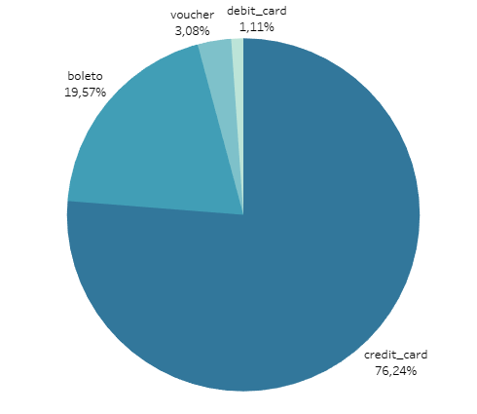

Credit Card Dominates as Primary Payment Method from 2017 to 2018, Far Surpassing Other Options
22

Slide 30
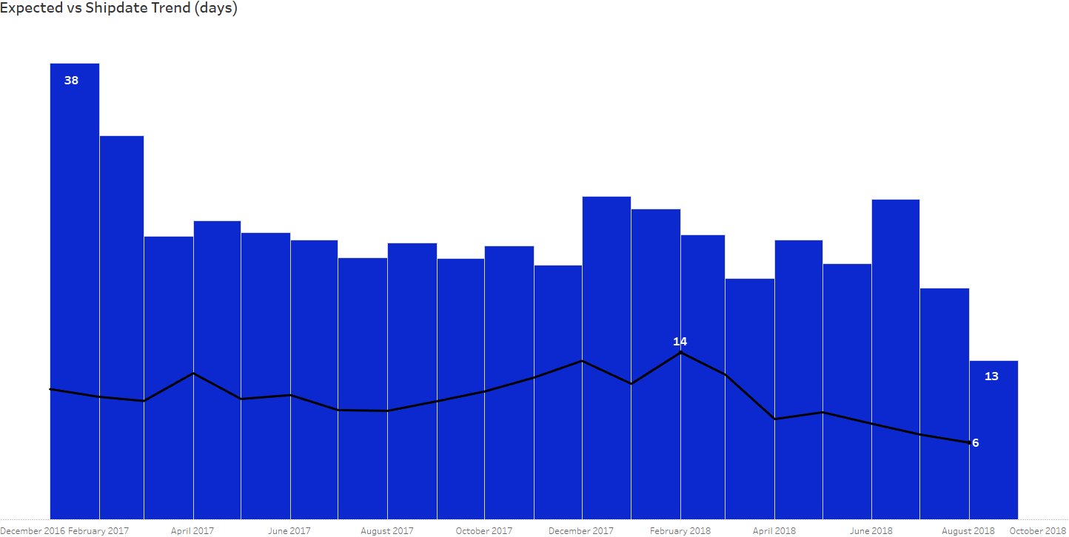
Unrealistic Delivery Promises Undermine Customer Trust — Ship Duration Identified as Main Cause (refer to slide 31)
: Expected Duration
: Actual Shipdate Duration
Key points :
Even the repeat buyers are still satisfied with the existing delivery performance, the company still has to make improvements in this regard. In addition to maintaining repeat buyers, it is also to convert new buyers into a new repeat buyers.
23

Slide 31

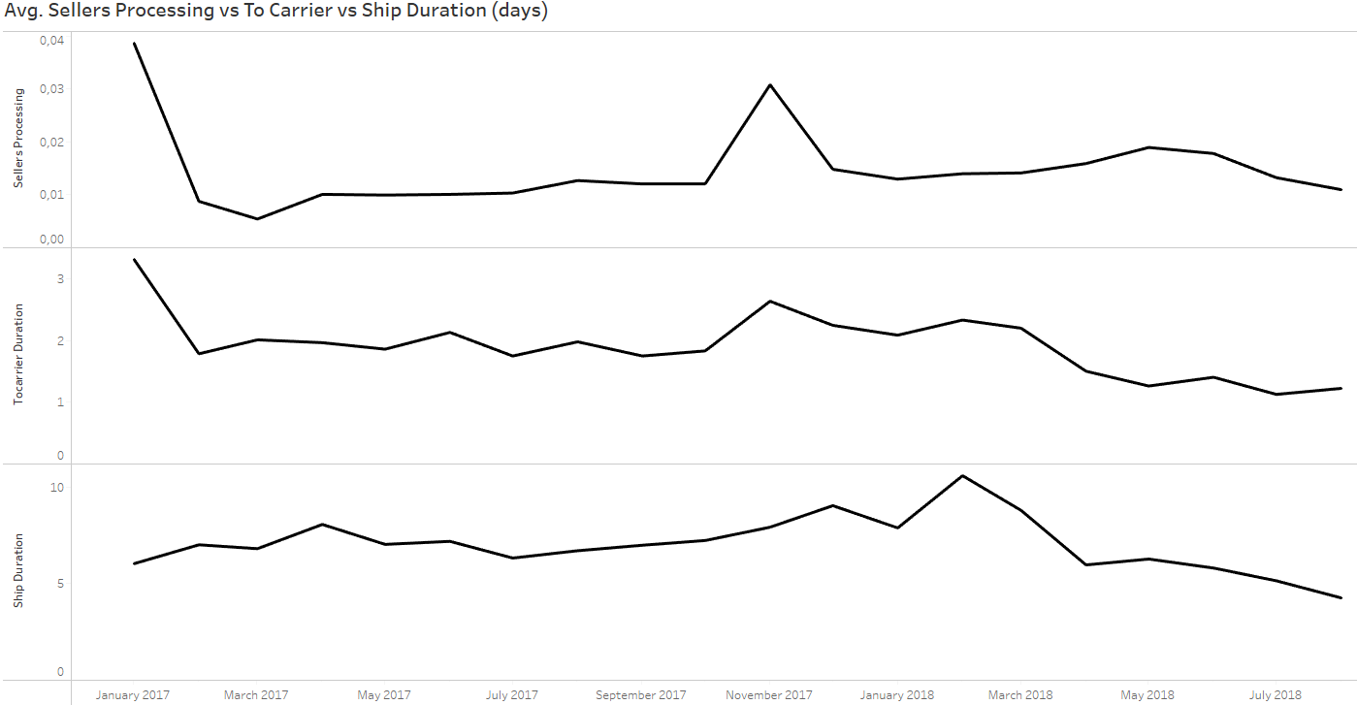
Significant Fulfillment Breakdowns Identified, with Seller Processing Delays Up to 60 Days and Shipping Lags Up to 205 Days, Undermining Customer Trust.
24

Slide 32
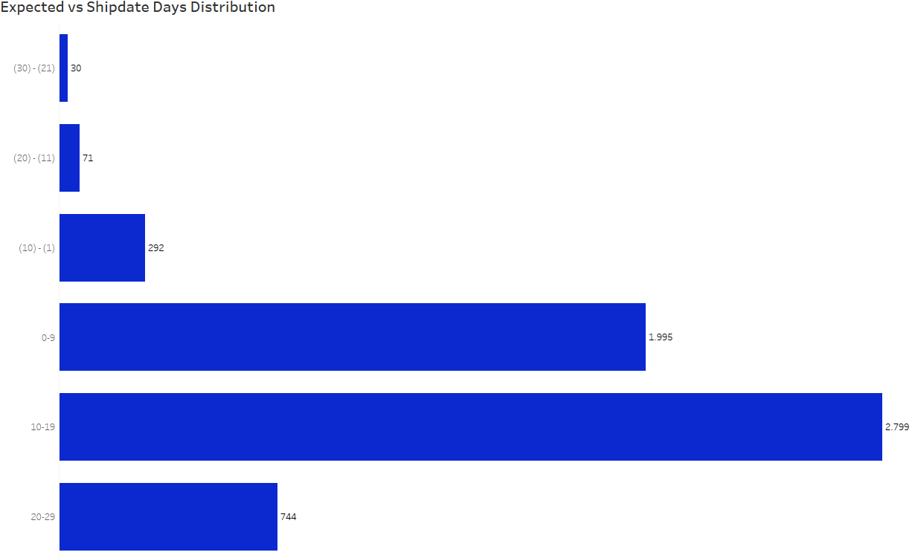
Improved Delivery Efficiency Has Boosted Sales, but Long Ship Durations Still Drive High Churn
25

Slide 33
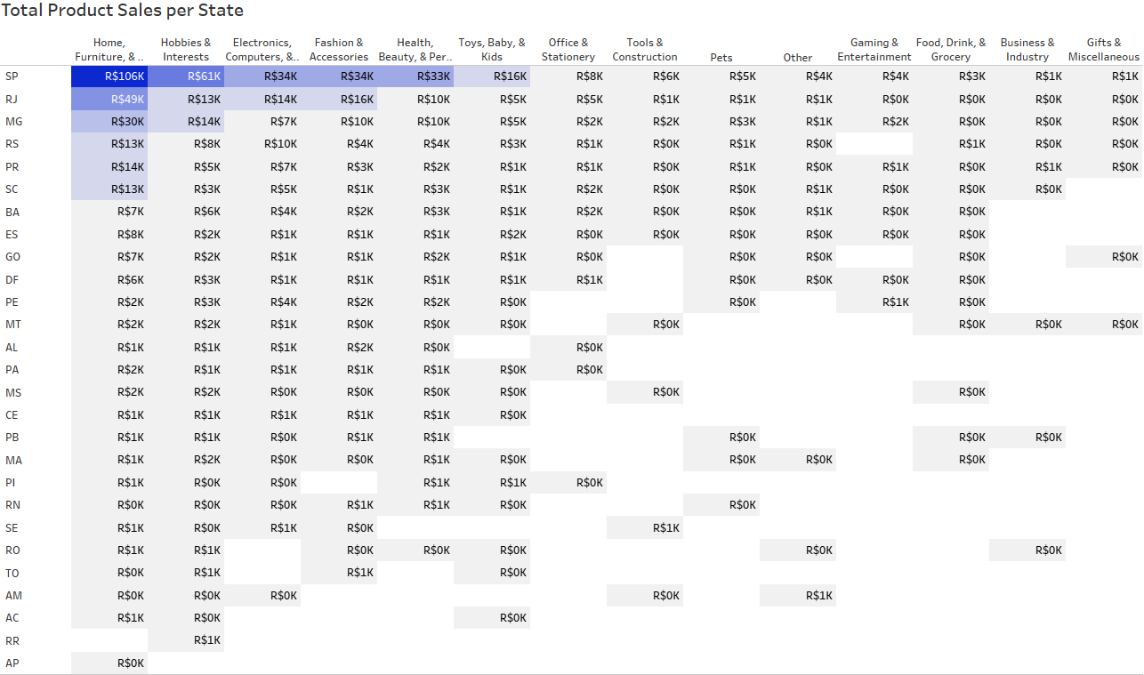
Sao Paulo State Leads in Sales Volume, Likely Influenced by Having the Lowest Freight Costs Among All States
26

Slide 34
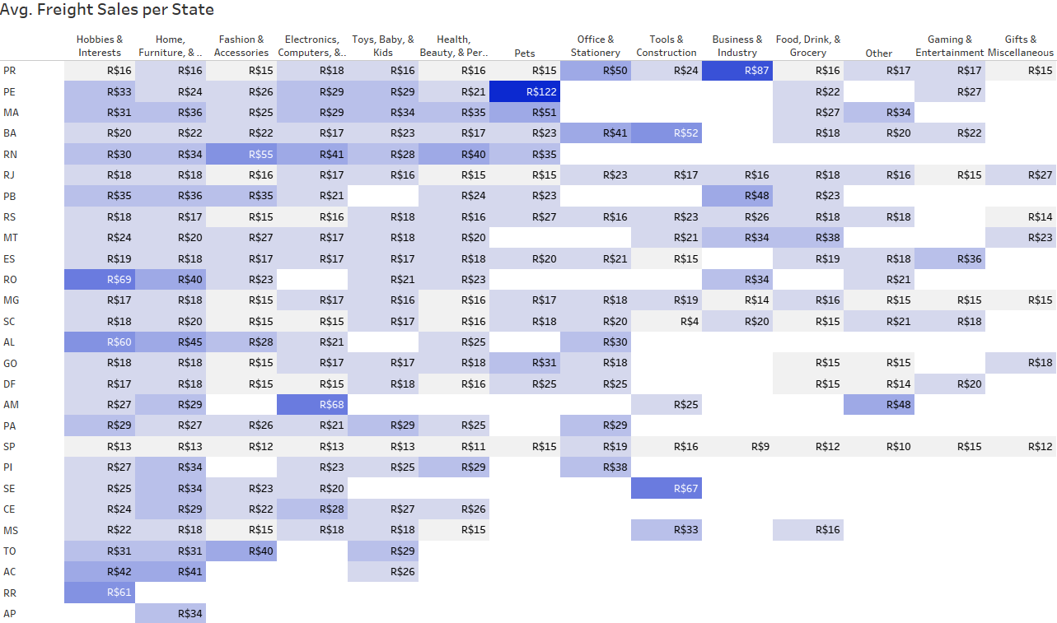
Sao Paulo State Leads in Sales Volume, Likely Influenced by Having the Lowest Freight Costs Among All States
27

Slide 35
Customer Segmentation

Slide 36
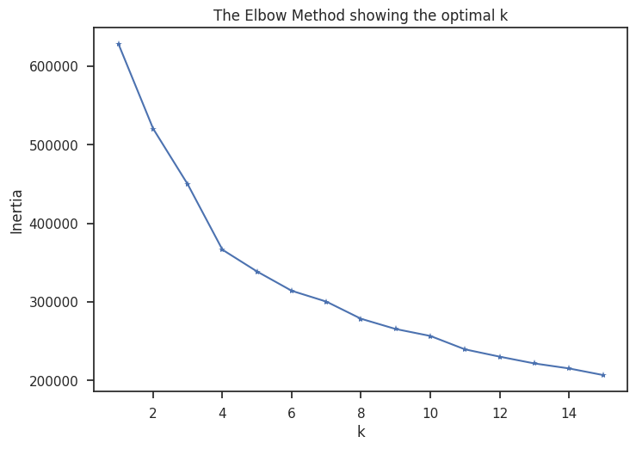
Customer Segmentation Reveals Four Distinct Buyer Profiles — Repeat Buyer Big Spenders Pose Retention Risk Despite Ongoing Activity
Business Opportunities :
Cluster (Budget Buyers)
- Excellent satisfaction (review score = 5).
- Strong base for volume-driven repeat sales.
Cluster (High Value Buyers)
- High-value and satisfied customers.
- Willing to spend more and likely purchase premium items.
Cluster (High Volume Buyers)
- Large volume, low spenders.
- High satisfaction but low engagement or frequency.
Cluster (Repeat Buyer Big Spenders)
- Extremely high value, but very dissatisfied (review score = 1).
- High risk of churn despite recent activity.
Feature Scaling :
expected vs shipdate
price
freight value
payment value
review score
time to shop
28

Slide 37
Repeat Order Prediction

Slide 38
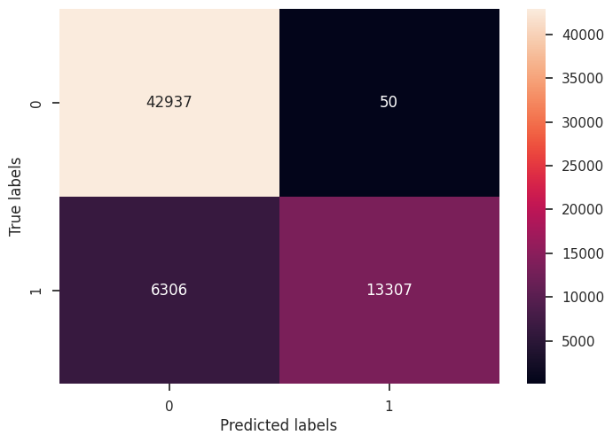



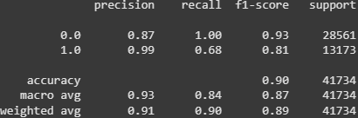

Model Achieves 89% Accuracy Without Overfitting — Perfect Precision but Moderate Recall Highlights Need for Better Detection of Repeat Buyers
Data Train
Results :
Of all those predicted to make a repeat order by the model, only 1% who actually didn’t take repeat order. (a few false positive)
The model successfully detected 68% of people who actually made a repeat order.
Data Test
29

Slide 39
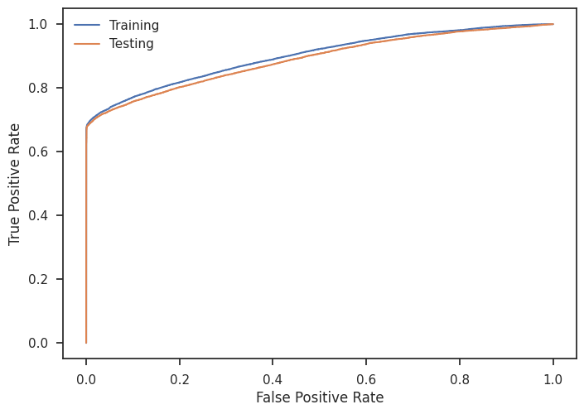
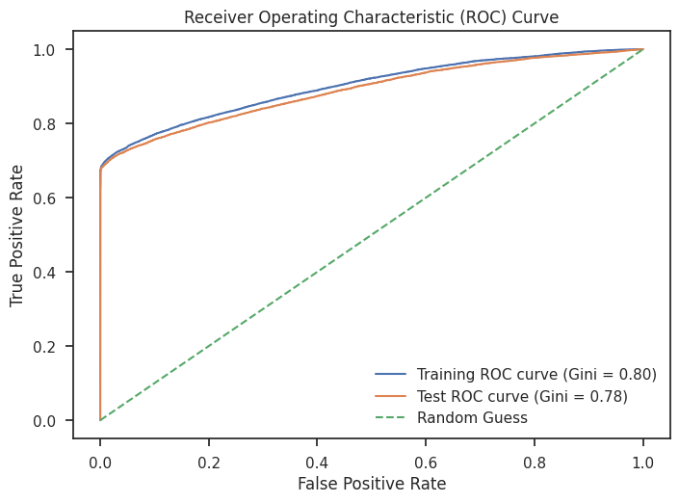
Model Demonstrates Strong Discriminatory Power with AUC of 0.888 and Gini Score of 0.777, Effectively Distinguishing Between Takers and Non-Takers
30

Slide 40
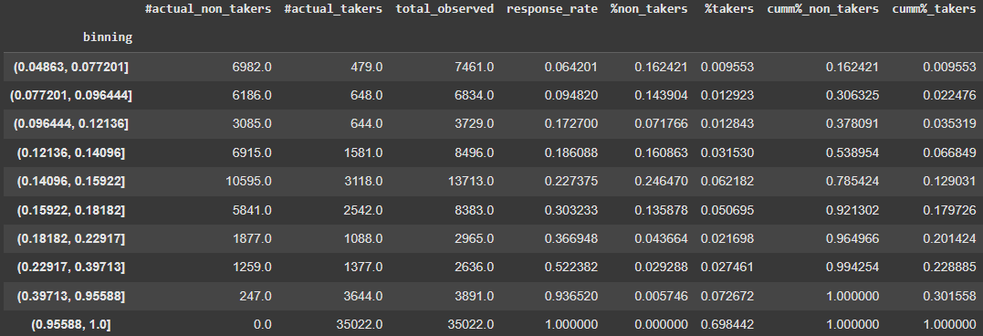
Model Demonstrates High Precision and Confidence, With Top 30% of Predictions Capturing 79.84% of Takers
Results :
Top deciles effectively can identify the most promising repeat buyers with :
Just the top 3 deciles (the top 30% of people) account for about 79.84% of all actual repeat buyers.
That’s exactly the model is focusing in on the right people.
As the score binning increase, the number of real repeat order takers also increases a lot. It indicates higher model scores clearly mean more likely real users.
31

Slide 41

Key Performance Indicator
Monitoring some critical KPI for the next 12 months :
KPI | Current | Target
Repeat Order Rate | 3% | 10%
Churn Rate | Very high | decrease 40%
Seller Processing Time | Up to 60 days | 2-3 days
To Carrier Duration | Up to 125 days | 3-4 days
Ship Duration | Up to 205 days | < 10 days
Freight Delays Incidents | Frequent | decrease 60%
Review Score (CSAT) | High bust missleading | > 4.0
32

